Slide 1
Hyderabad Omdena Chatbot Tableau for Beginners

Slide 2

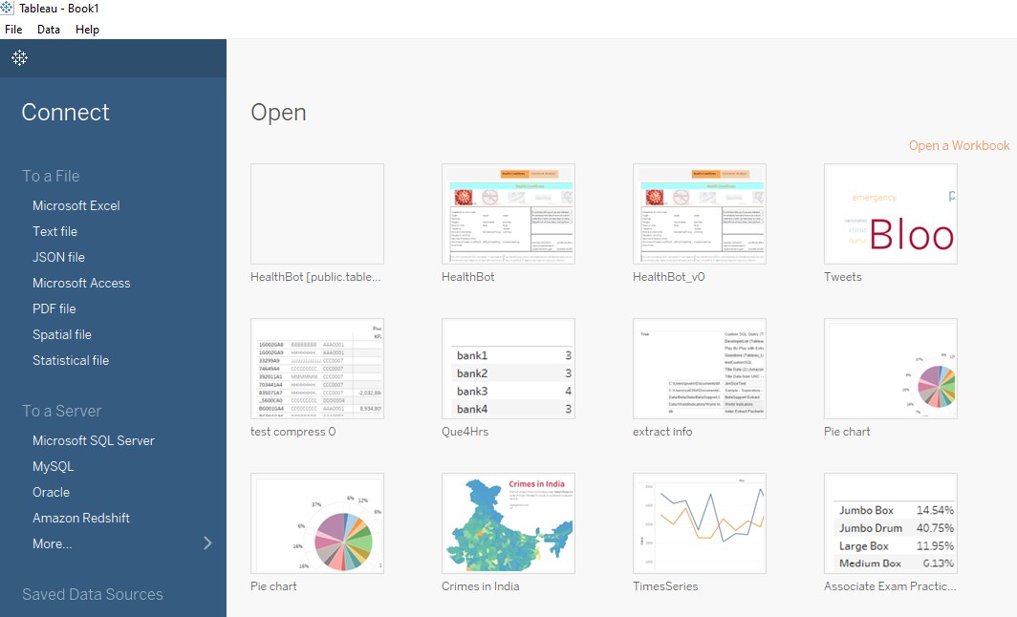
1. Navigate to Tableau Software from Windows Start Menu
2.Connect to data source file with Text File option. Ex: Final.csv

Slide 3
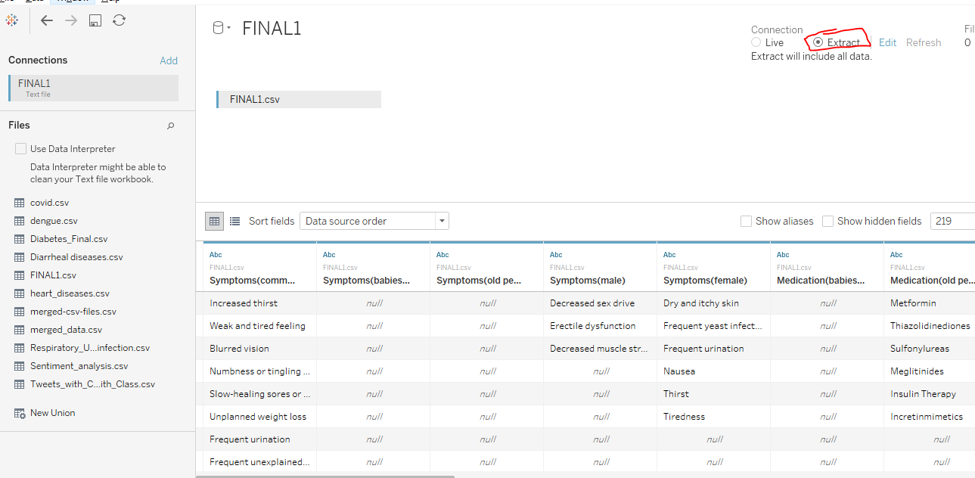
3. After connection is established, make the connection as ‘Extract’ mode and data can be previewed as below.

Slide 4
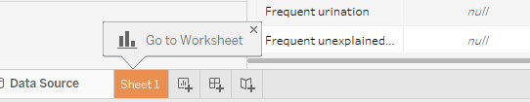
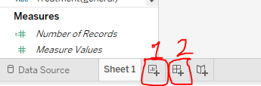
4. Navigate to the Sheet 1
5. Click in 1. to add new worksheet and 2 to add new dashboard.

Slide 5
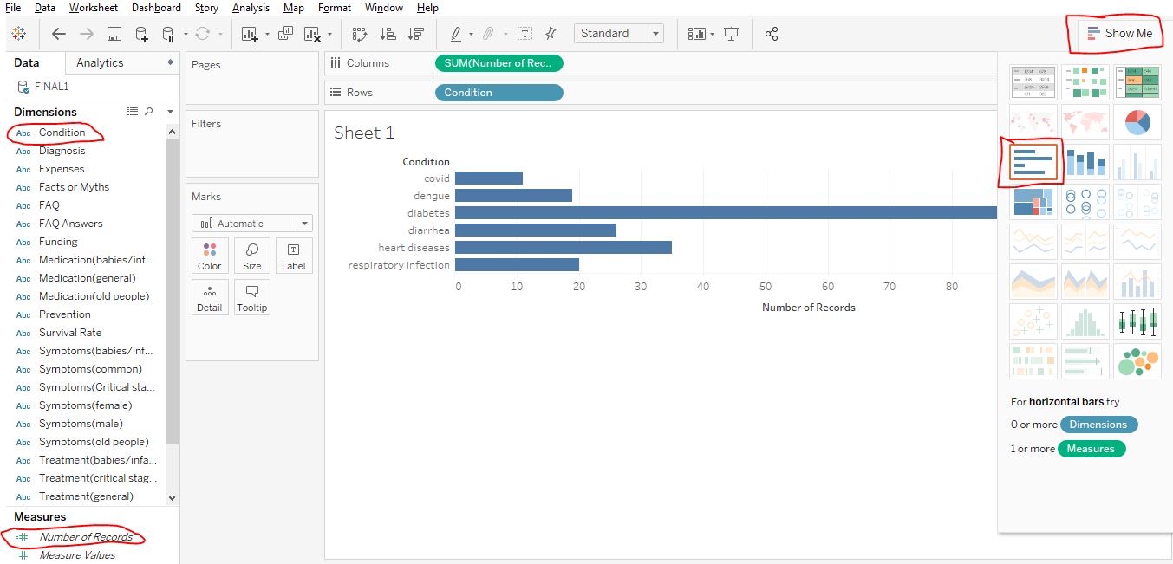
6. Navigate to the Sheet 1, drag the fields Conditions and Number of records to Rows and Columns respectively. Choose the type of relevant graph under Show me button.

Slide 6
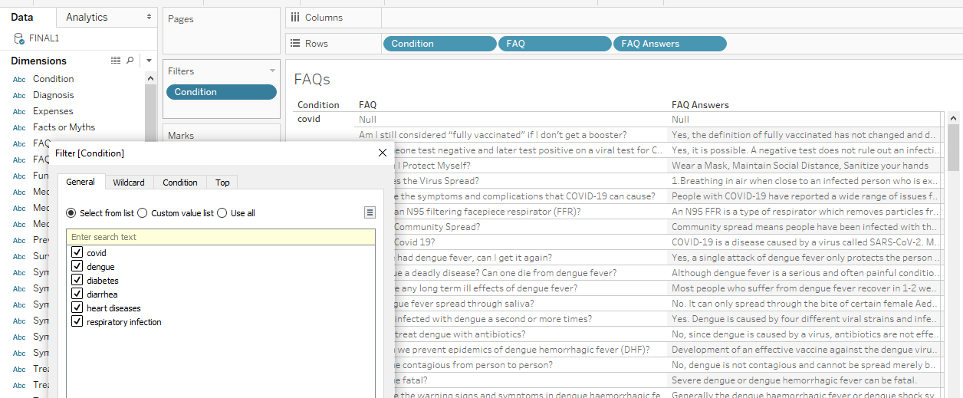
Using Filters
7. Drag the dimension that you wish to filter. Ex: drag the field conditions to filters pane and select the values to filter out the data.

Slide 7
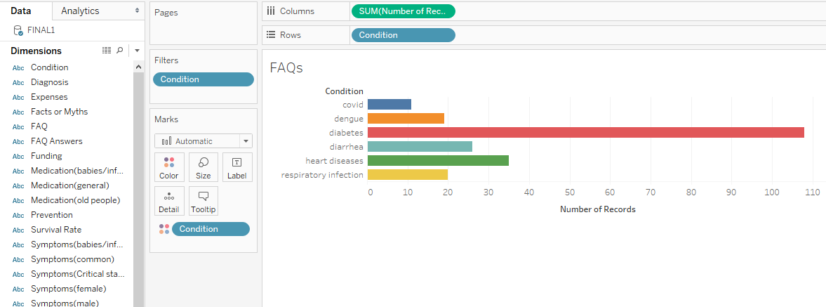
Using Color Palette
8. Drag the dimension that you wish to show different Colors. Ex: drag the field conditions to color palette.

Slide 8
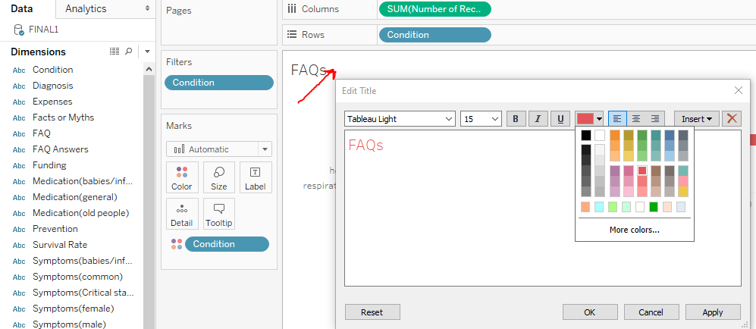
Adding Title and Font to Worksheet
9. Double click on the Title, Add the relevant title, choose the font and color and click ‘OK’

Slide 9
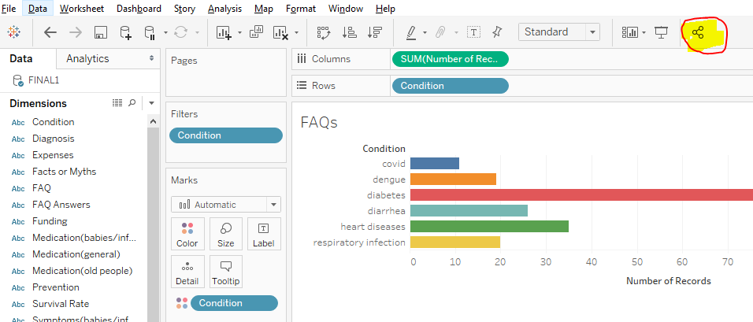
Publishing the worksheet/dashboard
10. Create Tableau Public online account. (https://public.tableau.com/en-us/s/). Click in the Share button.

Slide 10
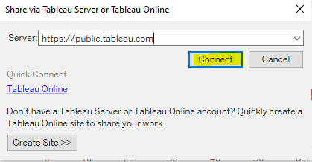
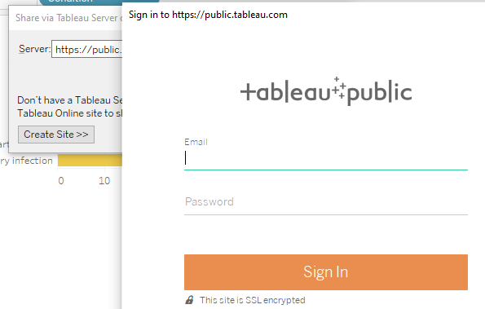
11. Provide the server URL and click on ‘Connect’ button.
12. Provide login credentials and Sign-In.

Slide 11
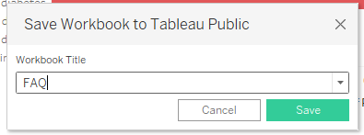
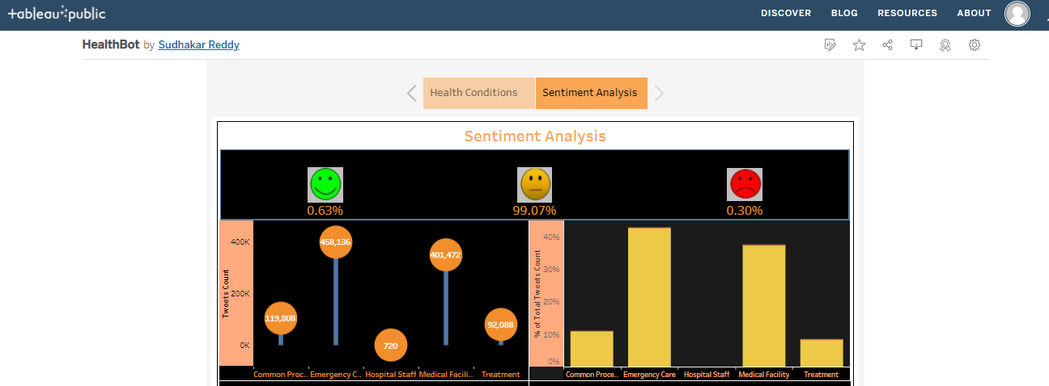
13. Provide workbook Title and Click ‘Save’ to publish online.
14. Finally, it will appear as dashboard online for public view.
https://public.tableau.com/app/profile/sudhakar.reddy7432/viz/HealthBot/Health?publish=yes

